Slide 1
Date and Time Module in Python
By: Bhimashankar Takalki

Slide 2
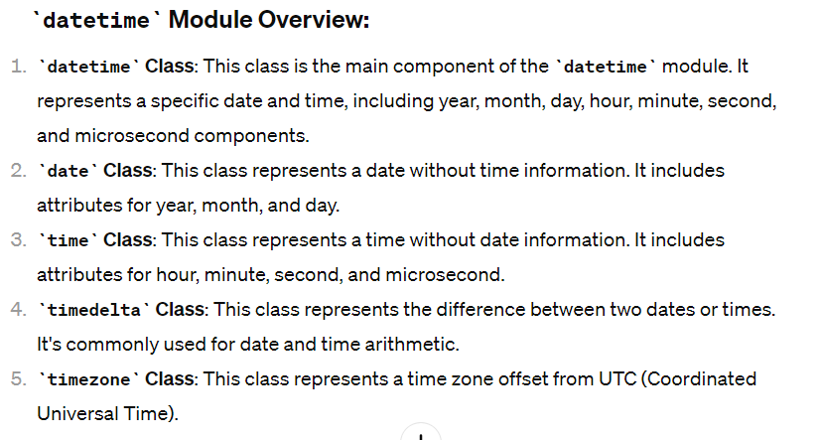
Date and Time Module
The datetime module in Python provides classes for manipulating dates and times. It includes classes like datetime, date, time, timedelta, and timezone, among others. These classes allow you to work with dates, times, and their combinations in a convenient and efficient manner.

Slide 3
1. Creating datetime Objects:
from datetime import datetime
# Current date and time
current_datetime = datetime.now()
print("Current Date and Time:", current_datetime)
# Specific date and time
specific_datetime = datetime(2023, 8, 15, 12, 30, 0)
print("Specific Date and Time:", specific_datetime)

Slide 4
2. Working with date Objects:
from datetime import date
# Today's date
today_date = date.today()
print("Today's Date:", today_date)
# Specific date
specific_date = date(2023, 8, 15)
print("Specific Date:", specific_date)

Slide 5
3. Working with time Objects:
from datetime import time
# Current time
current_time = time.now()
print("Current Time:", current_time)
# Specific time
specific_time = time(12, 30, 0)
print("Specific Time:", specific_time)

Slide 6
4. Using timedelta for Date Arithmetic:
from datetime import datetime, timedelta
# Current date
current_date = datetime.now()
# Calculate future date
future_date = current_date + timedelta(days=7)
print("Future Date (7 days later):", future_date)
# Calculate past date
past_date = current_date - timedelta(weeks=2)
print("Past Date (2 weeks earlier):", past_date)

Slide 7
5. Working with Time Zones:
from datetime import datetime
import pytz # Install using pip install pytz
# Convert naive datetime to timezone-aware datetime
naive_datetime = datetime(2023, 8, 15, 12, 30, 0)
timezone = pytz.timezone('America/New_York')
aware_datetime = timezone.localize(naive_datetime)
print("Timezone-aware Datetime:", aware_datetime)

Slide 8
6. Datetime module used to determine time to execute a part of code
import datetime
# Record the start time
start_time = datetime.datetime.now()
# Your code to execute
# Example: Sum of numbers from 1 to 1000000
total = 0
for i in range(1, 1000001):
total += i
# Record the end time
end_time = datetime.datetime.now()
# Calculate the time taken
time_taken = end_time - start_time
print("Time taken to execute the code:", time_taken)
In this example, the datetime.now() function is used to get the current date and time before and after executing the code. Then, the difference between these two timestamps (end_time - start_time) gives you the total time taken to execute the code.
Note: This method measures the elapsed time, including any delays caused by system processes or other factors. For more accurate performance measurements, you might consider using the timeit module, which is specifically designed for measuring execution times of small code snippets.

